Slide 1
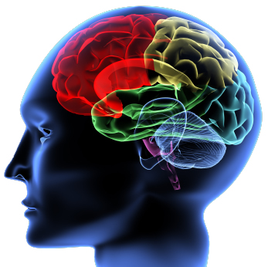
Neuropsychologists
What would I do?
Neuropsychologists use their knowledge of the relationship between the brain and neuropsychological function as a basis for investigation into the cognitive functioning of patients with suspected or established brain damage.
How do I become one?
At least an upper second class degree
Accredited postgraduate training through either a Clinical or Educational training route
BPS Qualification in Clinical Neuropsychology
Where can I obtain relevant experience?
Voluntary work for charities for individuals with brain injuries
Working with the NHS
Working with people with physical or mental health issues

Slide 2
Sport & Exercise Psychologists
What would I do?
Sport psychologists help athletes prepare for the demands of competition, training and the emotional consequences of an injury.
Exercise psychologists promote exercise participation and motivation levels in the general population rather than in athletes and can help with planning exercise regimes.
How do I become one?
At least an upper second class degree
Masters in sport and exercise psychology
Where can I obtain relevant experience?
Coaching a sports team
PE Teacher
Fitness Instructor
www.soton.ac.uk/psychology/sport_and_exercise

Slide 3
Other Career Pathways
Where can a degree in Psychology take me?
A Psychology degree provides graduates with a variety of transferable skills plus knowledge about how the human mind works and its influence on behaviour. Your study will have enabled you to develop excellent interpersonal skills and a great deal of other qualities.
What are these ‘transferable skills’?
Expertise in written and oral communication
Time and task management
Working well independently and as a team
Ability to handle complex written and numerical information
Ability to take a critical stance
Good project-management skills
We have alumni placed with all of these Employers
www.soton.ac.uk/psychology/other_careers

